Slide 1
C2T3: New Product Profitability Predictions
Sergio Robledo

Slide 2
Sampling, Dummy Variables and Training/Testing Sets
Sampling
80 Observations in Total
Low Amount of Data
40 Observations (50%) Chosen for Sampling
Dummy Variables
Data Type of the Product Type
Characters to Binary Variables
Training / Testing Percentage of Sample Observations
Training Set: 75%
Testing Set: 25%

Slide 3
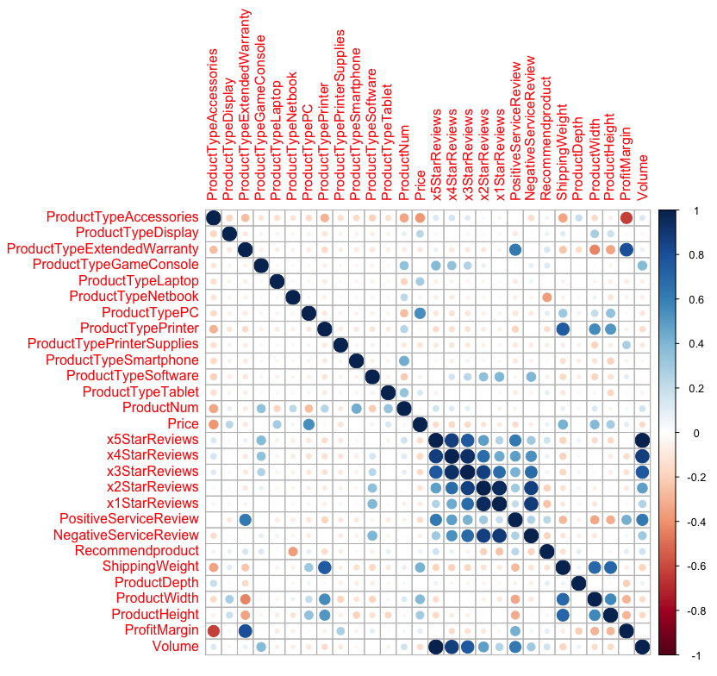
Correlation Between Sales Volume and Reviews
Strongest Correlation
5 Star Reviews
1.0 Factor of Correlation
Other Correlations
4 Star Review: 0.88
3 Star Review: 0.76
Positive Service Review: 0.62
2 Star Review: 0.49
Negative Service Review: 0.31
1 Star Review: 0.26
Everything Else
Negligible Influence

Slide 4
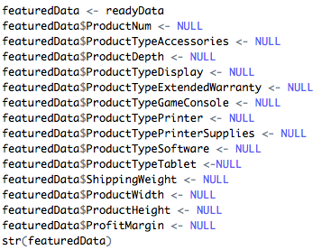
Feature Removal
Reasons for Removal
No Influence
Extra Noise during Prediction
Final Table
14 Variables
Contains
All Star Reviews
All Service Reviews
Sales Volume
4 Desired Product Types

Slide 5
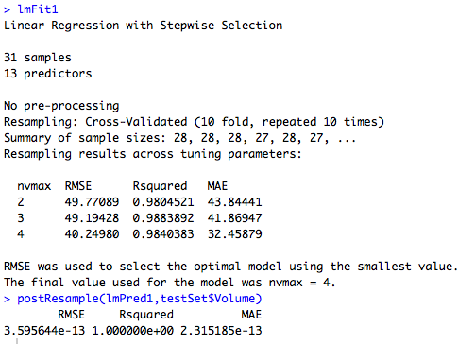
Linear Regression
Parameters Used
Stepwise Regression
4 Variables
Overfit to the Existing Data
R-Squared Value = 1
Perfect Fit for Known Data
RMSE Approximately ⇢ 0
Again Perfect Fit to Known Data
Perfect Performance on Known Data
Doesn’t Translate Well to Unknown Data
Not Good for Prediction of Variables
Conclusion
Not a Good Model for this Data

Slide 6

Gradient Boosted Model
100 Trees Used
Inaccurate
But Not Overfitted
R – Squared Value: 0.832
High Value but Not the Best
RMSE Value: 533.679
Very Inaccurate
2/3 of Existing Products Sales Volume < 450
Not a Good Option for our Data

Slide 7
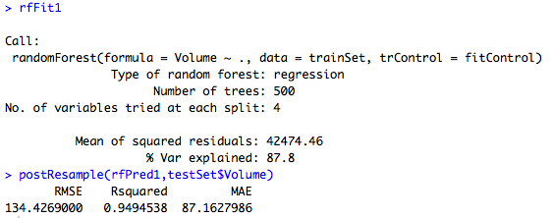
Random Forest: Best Performance Metrics
Chosen Model for Final Prediction
Very Accurate
Not Overfitted
R – Squared Value: 0.949
Perfect Fit = 1.0
RMSE Value: 134.426
Very Good Value
50% of all Existing Product Sales Volume > 150
Highest Performance
R - Squared Value Closest to 1
Not Overfitted
Lowest Non-Parametric RMSE

Slide 8
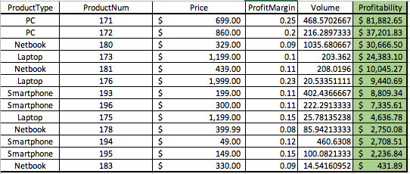
Predicted Sales Volume & Profitability
Predicted Sales Volume Doesn’t Equal Profitability
Profitability
Sales Volume * Price * Profit Margin
Product Number 171
Most Profitable Product Predicted
Profit = $81,882.65
Top Three Most Profitable Products
Product # 171
PC
$81,882.65
Product # 172
PC
$37,201.83
Product # 180
NetBook
$30,666.50

Slide 9
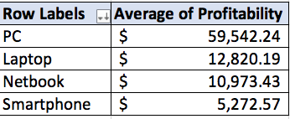
Product Type Most Profitable on Average
Portable Computers (PCs)
Most Profitable on Average
Average Profit = $59,542.24
Two PCs being Considered
Top 2 Spots for Most Profitable Products
Laptops
Second Most Profitable on Average
Average Profit = $12,820.19
Three Laptops Being Considered

Slide 10
Extra Questions Answered
Business Value acquired from this Analysis
PC Computers will bring the most profit to the company.
Rerunning Sales Projections with Different Models
Since the data had been pre processed in an earlier step, the application of the different predictive models was pretty straightforward.
Main Lessons Learned
Learning what type of model will work with what type of data.
Parametric vs. Non-Parametric
Pre – processing your data saves you a lot of time in the long run.
Final Recommendations…
Put both PCs on the market
Whatever budget you have left focus it on laptops
Laptops were on average the second most profitable product type

